Slide 1
Aircraft Jet Engines and Propulsion
Systems
(Jet Propulsion and Control – Final Exam May 2011)
Dr. John Polley
Dr. K.K. Bofah

Slide 2
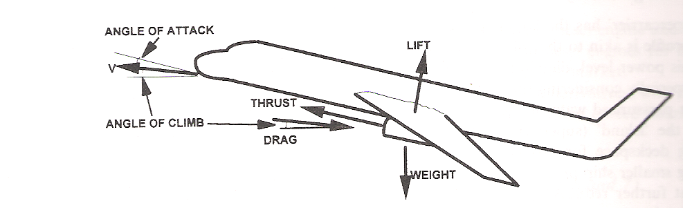
Forces Acting on an Aircraft
WINGS
Use the diagram above to complete these functional descriptions
The __________ works to make the plane go up. _________ is due
mainly from its _____________
The ____________ of the aircraft acts vertically downwards through the center of gravity. In level flight, the _____________must equal the _______________
The ____________ acts against the direction of motion . In level flight it acts horizontally. It acts to slow the plane down
The Engine ________________ acts along the engine center line. In level, steady flight _____________ must equal _____________
1

Slide 3
Forces Acting on an Aircraft
ANSWER
WINGS
Use the diagram above to complete these functional descriptions
The _LIFT__ works to make the plane go up. __LIFT__ is due
mainly from its __WINGS __
The __WEIGHT__ of the aircraft acts vertically downwards through the center of gravity. In level flight, the __LIFT__must equal the __WEIGHT__
The __DRAG __ acts against the direction of motion . In level flight , it acts horizontally. It acts to slow the plane down
The Engine __THRUST__ acts along the engine center line. In level, steady flight __THRUST__ must equal ___DRAG__
1

Slide 4
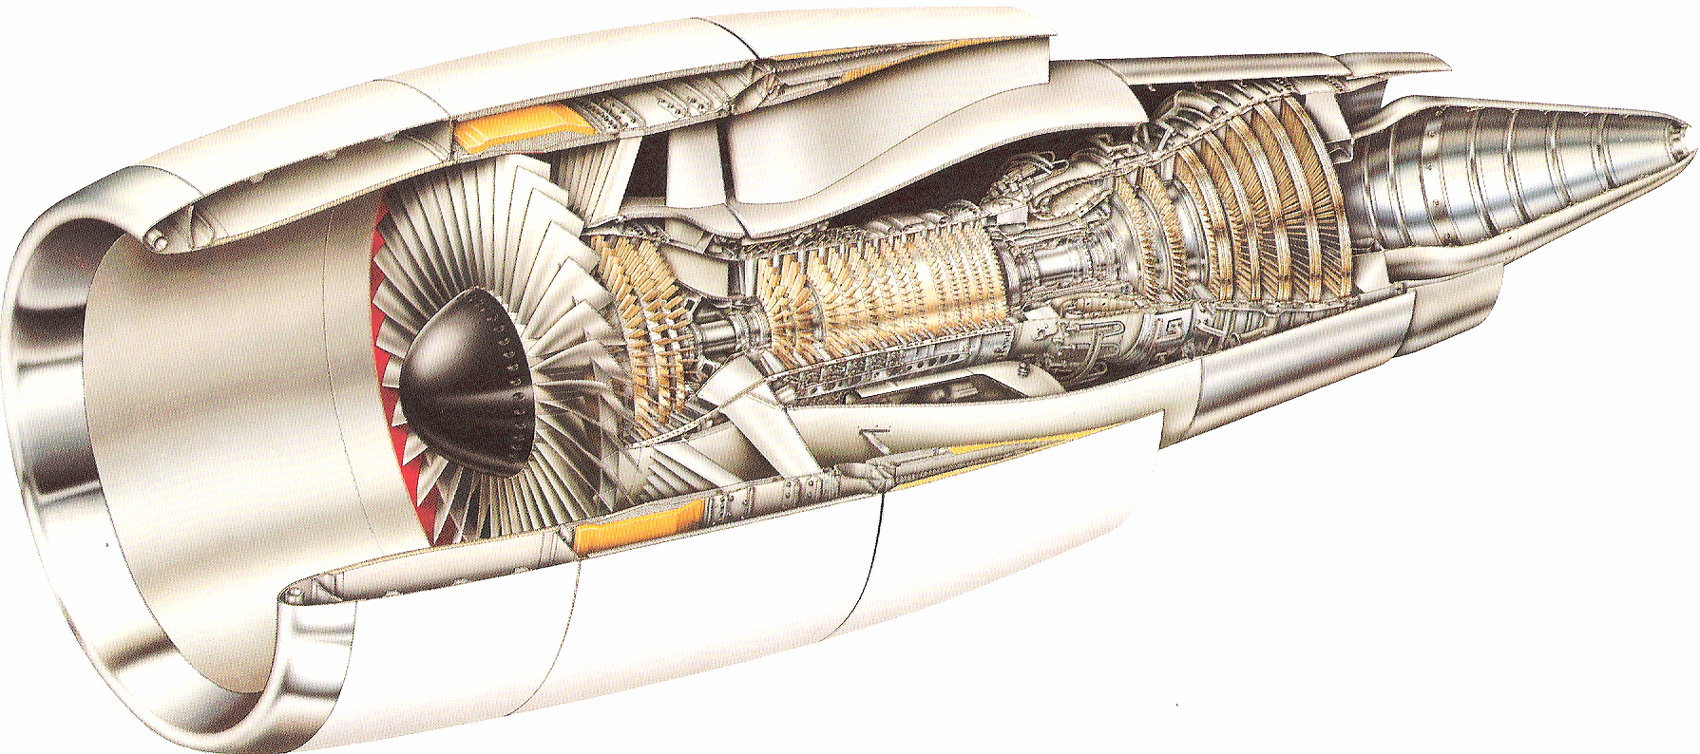
Jet Propulsion System – GE CF6-80C2
Used in the Boeing 747 Aircraft
Fill in
-- Combustor
-- Nacelle
-- HP Turbine
-- LP Compressor
-- Fan
-- LP Turbine
-- HP Compressor
7
2
4
1
6
5
3
What engine is shown in this picture? Turbojet, Turboprop,Turboshaft, Turbofan?
Fill in the names of the pointed engine components. Names are given
2

Slide 5
ANSWER
Jet Propulsion System – GE CF6-80C2
Used in the Boeing 747 Aircraft
Fill in
1 -- Nacelle
2 -- Fan
3 – LP Compressor
4 -- HP Compressor
5 -- Combustor
6 -- HP Turbine
7 -- LP Turbine
7
2
4
1
6
5
3
What engine is shown in this picture? Turbojet, Turboprop,Turboshaft, Turbofan? TURBOFAN
Fill in the names of the pointed engine components. Names are given
2

Slide 6
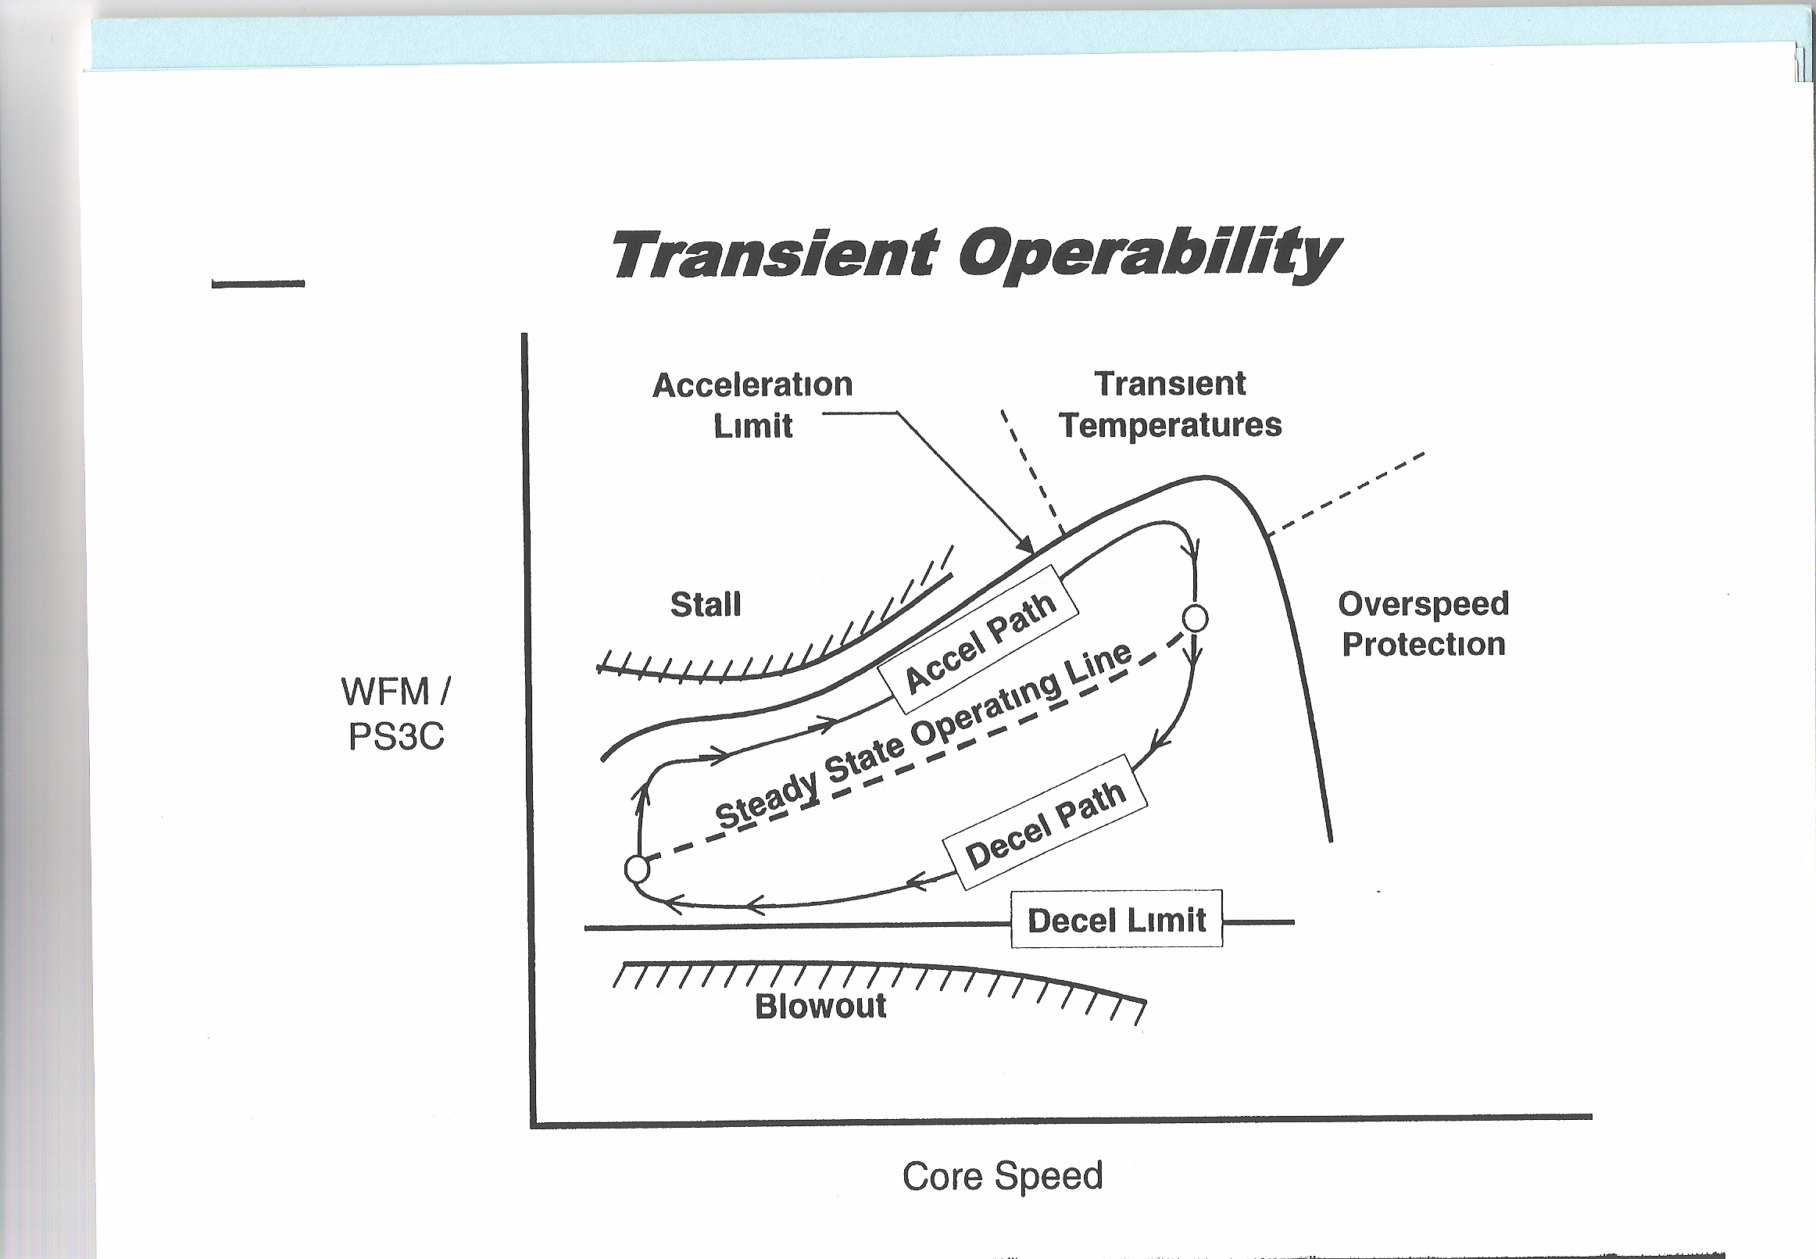
3. Describe the complex operation of aircraft engine control
from start to full power. Use the diagram below. Include
variables to be protected.
TURBOFAN TRANSIENT CONTROL
Fuel Flow/
Compressor
Discharge
Presssure
START
3

Slide 7
Answer:
Follow steady-state operating line, accel path increasing power decel path decreasing power ,obeying Accel limit, Decel Limit , Protection required for following variables (stall, temperature ,overspeed,, blowout )
TURBOFAN TRANSIENT CONTROL
TURBOFAN TRANSIENT CONTROL
Fuel Flow/
Compressor
Discharge
Presssure
Fuel Flow/
Compressor
Discharge
Presssure
START
3

Slide 8
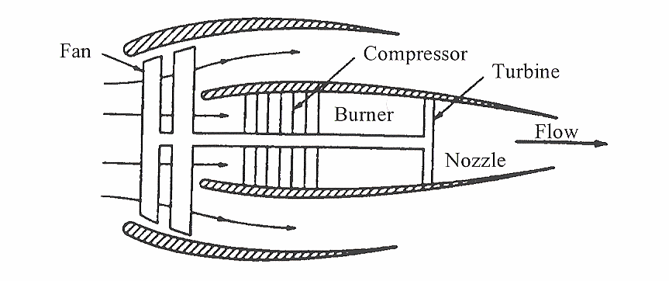
Engine Control System Design
What is the main purpose of an aircraft engine control system?
2. What are the 4 key engine parameters protected by the control system?
4

Slide 9
ANSWER
Engine Control System Design
What is the main purpose of an aircraft engine control system?
Purpose : inject fuel – get thrust as commanded by the Pilot
2. What are the 4 key engine parameters protected by the control system?
stall margin (fan , compressor)
overtemperature of (turbine hardware)
blowout of combustor
overspeed (fan, compressor)
4

Slide 10
What is the fundamental equation for describing
and adding the transient characteristics to the steady- state aircraft engine model? Fill in the question marks
------ Governing Equation of Engine Transient Model
T = IK d( ? )/dt
where: T - ( ? ) ---- ft lb
K - Conversion Factor ---- rad/sec/rpm
I - ( ? ) ---- slug ft²
Rotor Inertia,
Rotor Torque
Rotor Speed
5

Slide 11
ANSWER
What is the fundamental equation for describing
and adding the transient characteristics to the steady-state aircraft engine model? Fill in the question marks
------- Governing Equations in Transient Model
T = IK d(XN)/dt
where: T - Rotor Torque ---- ft lb
K - Conversion Factor ---- rad/sec/rpm
XN - Rotor Speed ---- rpm
I - Rotor Inertia ---- slug ft²
5

